Slide 1
OPENACC FOR PROGRAMMERS - Concepts and Strategies
Learn to use directives for rapid and portable code development
Learn about performance tools for parallel programs
Understand how the compiler works under the hood
Know programming guidelines and best practices
Learn about other popular parallel programming paradigms
Study interoperability of OpenACC with other models
Explore research topics with OpenACC
Editors:
Sunita Chandrasekaran
Guido Juckeland

Slide 2
Chapter 01 OpenACC Specification Simplified
High-level directive-based programming model across platforms
Identify available parallelism, Express parallelism, Express data movement, Optimize loop performance
Commonly used parallel constructs for parallel execution
parallel, kernels, loops, routine
Data clauses to allocate/deallocate memory on GPU, copy data to/from GPU/host, indicate data present on GPU
copy, copyin, copyout, create, present, deviceptr
Express data locality
Directives to better utilize devices’ caches
cache
By James Beyer, NVIDIA, USA
Sunita Chandrasekaran, UDEL, USA
Guido Juckeland, HZDR, Germany

Slide 3
Chapter 02 Loop level parallelism
Splitting work or loop iterations across different hardware units
OpenACC’s execution model has 3 levels: gang, worker and vector
 | Mapping of
Platform | Gang | Worker | Vector
Multicore CPU | Whole CPU (NUMA domain) | Core | SIMD Vector
Many-core CPU (e.g. Xeon Phi) | Whole Chip or quadrant (NUMA Domain) | Core | SIMD Vector
NVIDIA GPU (CUDA) | Threadblock | Warp | Thread
AMD GPU (OpenCL) | Workgroup | Wavefront | Thread
By Adrian Jackson, EPCC, UK

Slide 4
Chapter 03 Programming Tools for OpenACC
Profiler tools help identify code characteristics
Performance tools available with OpenACC support
NVIDIA Profiler
Score-P
TAU
General strategies to identify bugs in OpenACC programs
Use –Minfo=accel to gather more information on compilation output
Isolate the bug by moving code from OpenACC compute regions back to the host.
Use debuggers – TotalView and Allinea DDT
By Robert Dietrich, TU Dresden, Germany
Sameer Shende, UOregon, USA

Slide 5
Chapter 03
Performance Analysis Layers and Terminologies

Slide 6
Chapter 03
Nvvp visualization of OpenACC activities

Slide 7
Chapter 03
Score-P and visualization using CUBE

Slide 8
Chapter 03
Vampir Trace Visualization

Slide 9
Chapter 03
TAU Paraprof

Slide 10
Chapter 03
Parallel debugging with Allinea DDT

Slide 11
Chapter 04 Using openacc for first program
Find hotspots in a given serial code (use profilers, Chapter 03)
Use compilation messages –Minfo=acc to obtain some feedback on the code
Understand and measure performance of the OpenACC program
Optimize OpenACC program
Reduce data movement
Avoid unnecessary transfer of data in and out of the device
Learn when to use parallel vs kernels
Create an efficient, high-level, portable and maintainable code base
By John Urbanic, PSU, USA

Slide 12
Chapter 04
Advantages of using OpenACC
Programmers can incrementally improve the code
Programmers can maintain a single code base
Programmers can still compile the code ignoring the acc directives
Programmers are offered software abstraction
More time to spend on science and less time on programming
By John Urbanic, PSU, USA

Slide 13
Chapter 05 Compiling openacc
How does a compiler compile an OpenACC code?
How do loops map to a parallel hardware?
Variables need to be allocated to the proper level in the memory hierarchy
Dataflow analysis help recognize reductions
Compilers help identify bugs that the programmer may miss
Compilers building dependency graph is key to uncovering improper parallelization
Control flow analysis with branch analysis on GPUs
By Randy Allen, Mentor Graphics, USA
Notes:
Wanted to mention dataflow, controlflow and dependency graph analysis

Slide 14
Chapter 06 best programming practices
Hot spots programmer should look, for acceleration:
Identify portions of code responsible for a large percentage of the application runtime (see profiles, Chapter 03)
Identify routines containing parallelizable math with a limited amount of other operations such as I/O or MPI communication.
Identify routines called a limited number of times
Maximize on-device computation
Optimize data locality
Minimize data transfers between system memory and device memory
Strategically increment acceleration and verification
By David Gutzwiller, Numeca, USA

Slide 15
Chapter 06
Hardware and algorithmic factors impacting acceleration
Number of parallel loop iterations, depending on the size of the dataset
Mathematical intensity of each loop iteration
Number and size of necessary data transfers
Speed and latency of the transfer bus (PCIe2, PCIe3, NVLink)
CPU model and performance
Accelerator model and performance
Number of processes concurrently offloading work to the accelerator
By David Gutzwiller, Numeca, USA

Slide 16
Chapter 06
Programming practices guidelines
Only transfer the minimum data needed for your algorithm
Consider executing marginal parallel regions between computation hot spots on the device to avoid data transfer overhead
Aggregate small, unrelated data structures in a single transfer
If possible, refactor 2D arrays into linearized 1D arrays
Allow data reuse; leave data on the device for as long as possible
present clause – a good indicator of data residing in device memory
Nested structured data regions - resulting in many small structured data regions and poor data locality
Unstructured data regions allows the creation, update, and deletion of device data at any point in the code
By David Gutzwiller, Numeca, USA

Slide 17
Chapter 07 OpenACc performance and portability – a comprehensive study
Approaches and relevant compilation flags to target multiple platforms
Approaches to target different types of system memory
Discrete, Shared and Partially Shared Memories
Trade-offs maintaining single code base Vs achieving best performance
Case study: Hardware Accelerated Cosmology Code micro kernel (HACCmk)
By Graham Lopez, Oscar Hernandez, ORNL, USA

Slide 18
Chapter 08 Additional approaches to parallel programming
Model | Implementation | Supported Lang | Target Architecture
OpenACC | Directives | Fortran, C, C++ | CPUs, GPUs, OpenPOWER
OpenMP | Directives | Fortran, C, C++ | CPUs, Xeon Phi, GPUs
CUDA | Language Extension | (Fortran), C, C++ | GPUs (NVIDIA)
OpenCL | Language Extension | C, (C++) | GPUs (CPUs) FPGAs
C++ AMP | Language Extension | C++ | CPUs, GPUs,
Kokkos | C++ Abstraction | C++ | CPUs, GPUs,
RAJA | C++ Abstraction | C++ | CPUs, GPUs,
TBB | C++ Abstraction | C++ | CPUs
C++ 17 | Language Feature | C++ | CPUs
Fortran 2008 | Language Feature | Fortran | CPUs
By Christian Trott, SNL, USA

Slide 19
Chapter 09 Openacc and interoperability
Interoperability of OpenACC with native or low level APIs
Calling native device code from OpenACC
Calling OpenACC from native device code
Interoperability of OpenACC managed memory used by kernels written in a native device API
Mapping of CUDA streams or device memory to OpenACC constructs
By Jiri Kraus, NVIDIA, USA

Slide 20
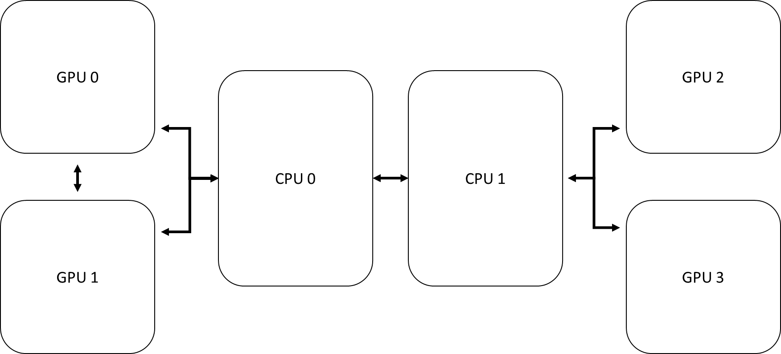
Chapter 10 advanced openacc
Utilizing two or more accelerator devices to increase performance
acc_set_device_num
acc_set_device_type
acc_get_device_type
Combining OpenACC with Message Passing Interface (MPI)
Asynchronous programming enabled by Software Pipelining
wait directive
async clause
By Jeff Larkin, NVIDIA, USA

Slide 21
Chapter 11 innovative research ideas using openacc – part 1
Sunway OpenACC
Newer extensions and functions to the OpenACC syntax for SW26010 Many-core platform
Creating optimized data transfer control annotations, swap/swapin/swapout and pack/packin/packout
Open Source OpenUH
Exploring distribution of loop nest across GPU thread hierarchy
Investigating multiple dimensional thread topologies for loop scheduling
By Lin Gan, TsinghuaU/National Supercomputing Center in Wuxi, USA
Daniel Tian, NVIDIA, USA

Slide 22
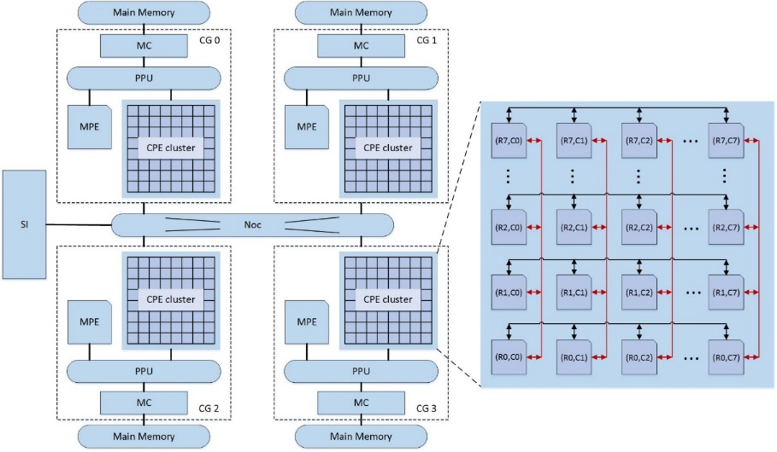
Chapter 11
Sunway: Architecture of SW26010 CPU
By Lin Gan, TsinghuaU/National Supercomputing Center in Wuxi, USA

Slide 23
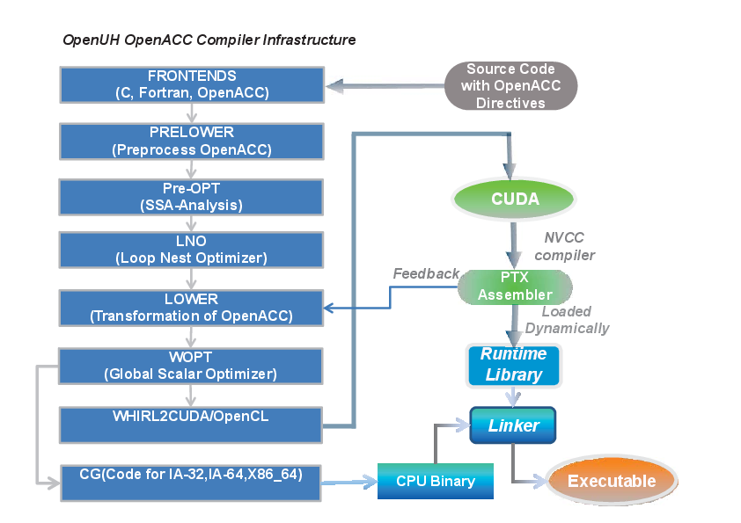
Chapter 11
Sunway: Compiler Transformation of Nested Loops for Accelerator
By Daniel Tian, NVIDIA, USA

Slide 24
Chapter 12 innovative research ideas using openacc – part 2
OPENARC: Framework for directive-based high performance reconfigurable computing
Source-to-source translation of OpenACC C program into an output CUDA or OpenCL program
Directive extension for loop unrolling, kernel vectorization, compute unit replication
XACC: Programming Accelerated Clusters using XcalableACC
A hybrid programming model using XMP and OpenACC directives
Exploring novel directives such as distribute, template for inter-node communication
By Seeyog Lee, ORNL, USA
Jinpil Lee, Riken, Japan

Slide 25
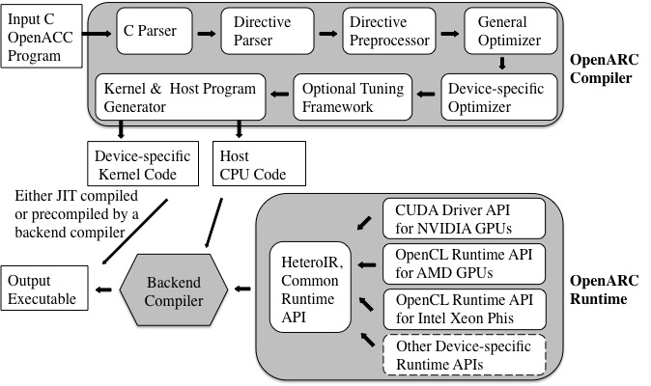
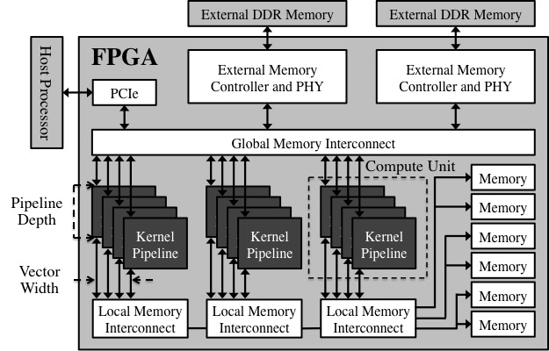
Chapter 12
OpenARC: System Architecture, FPGA OpenCL Architecture
By Seeyog Lee, ORNL, USA

Slide 26
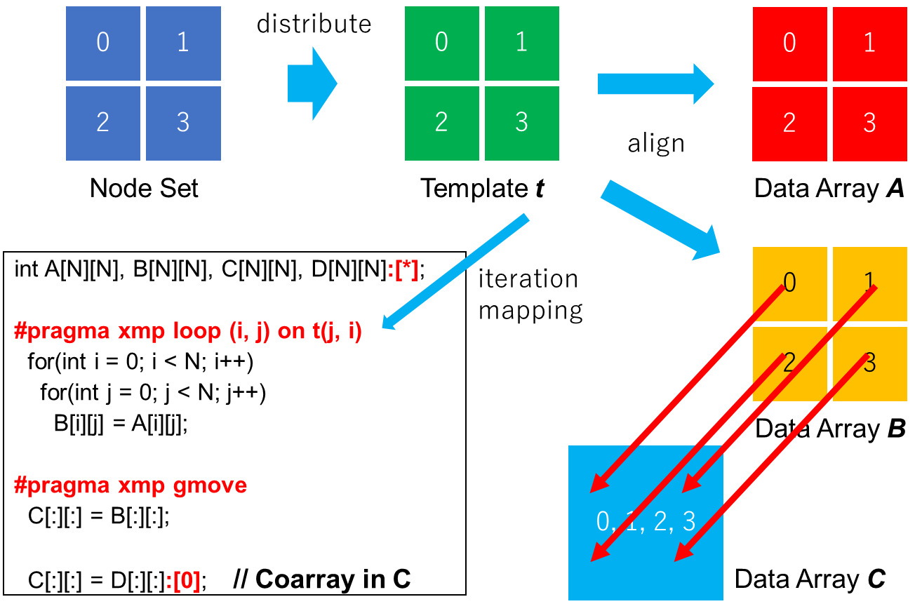
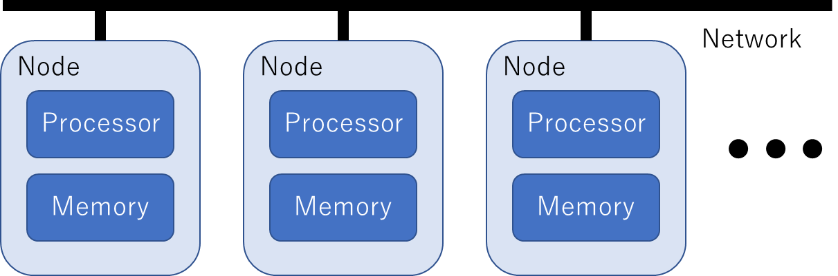
Chapter 12
XACC: Hardware Model, Data distribution and Mapping
By Jinpil Lee, Riken, Japan

Slide 27
Teaching proposal
Almost each chapter has codes to go with it
Codes could be structured as lab exercises
Sample codes, Exercises & Solutions
https://github.com/OpenACCUserGroup/openacc_concept_strategies_book
An OpenACC capable compiler is needed to compile all codes
GCC OpenACC https://gcc.gnu.org/wiki/OpenACC
PGI Community Edition (http://www.pgroup.com/products/community.htm
Authors are encouraged to contribute lecture slides on their materials to GitHub

Slide 28
THANK YOU for using our textbook ☺

